Slide 1
COMP 4290
Week 13 - Wednesday

Slide 2
Last time
What did we talk about last time?
Security planning
  Security plans
  Business continuity plans
  Incident security plans

Slide 3
Questions?

Slide 4
Project 3

Slide 5
Hussein Al-Ani Presents

Slide 6
Physical Security

Slide 7
Natural disasters
Flood
  Water is problematic, but usually there's some warning
  Hardware and software is replaceable
  Data often is not
    Backups should be made
    Critical hard drives should be marked so that they can be removed first
Fire
  Fire is worse
  There is usually less time to react and the threat to humans is bigger
  Fire suppression systems for computing facilities should not use water
    Using CO₂ or similar is good for computers but can kill humans
Everything else
  Have contingency plans
  Insure physical assets
  Maintain off-site backups of critical data

Slide 8
Power issues
Power loss
  Causes vary
  In some countries, multiple power losses per day are routine
Uninterruptible power supplies (UPS)
  Stores energy when there is power so that you can keep your systems running when there isn't
  Consumer UPSs are usually batteries
    Not a good solution for a large data center
  Large scale solutions are kinetic storage systems or generators
  UPSs generally only give you enough time to save data and do a safe shutdown
Surge suppressor
  Power is not constant and can have drops, spikes, and surges
  Surge suppressors are inexpensive and should be used for all computer power supplies
  If possible, computers should be disconnected from power (and from phone and other outside lines) during a thunderstorm

Slide 9
Human vandals
Unauthorized access
  With networked systems everywhere, people eavesdropping on connections is easier
  Normal employees are also using computing resources for personal use
Theft
  PCs, laptops, phones, tablets, and portable media are easy to steal
Preventing access
  Use a guard, a lock (traditional or swipe card)
Preventing portability
  PCs can be locked to the desk
  Motion sensors to see when someone is where they shouldn't be
Detecting theft
  RFID tags

Slide 10
Disposing of sensitive information
Shredding paper documents
  Some kinds of tape can also be shredded
  High sensitivity data should be burned after shredding
Overwriting magnetic data
  Deleting files does not stop digital forensics experts
  Data on disks should be overwritten many times with random patterns of 1s and 0s (burning)
Degaussing
  Passing a disk through a magnetic field so intense that all data is lost
Van Eck phreaking safeguards
  Many computer components emanate electromagnetic radiation that can be reconstructed
  Tempest is a government certification standard for blocking these emissions (meeting the standard can be expensive)
  An entire building (such as the NSA headquarters near DC) can be shielded in copper to protect emissions

Slide 11
Backups
Everything should be backed up, always
A complete backup covers the current state of all data
Revolving backups keep the last few complete backups
A selective (or incremental) backup stores only the files that have changed since the last backup
Ideally, you should have an offsite backup of all your data in case of fire or flood
  Writing your critical data to a USB drive and keeping it at home or school or vice versa is a good idea for you guys

Slide 12
Recovery
Networked storage can allow for continuous offsite backups and make recovery easier
If a computing center is destroyed or unusable, a cold site or shell is a facility with power and cooling where you can quickly rebuild a data center
  You have to supply the hardware
A hot site has ready to run computer systems of the kind you might need
  You can pay a monthly fee to be ready to move into such a site at a moment's notice
  A kind of data availability insurance

Slide 13
Lockpicking

Slide 14
Locks
Locks have been in use since ancient times and probably developed independently in the great ancient civilizations
Locks you are likely to run into are:
  Warded locks
  Wafer tumbler locks
  Pin tumbler locks
  Combination locks

Slide 15
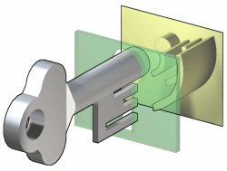
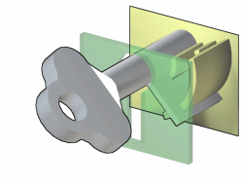
Warded locks
Warded locks have existed since antiquity
The shape of the key must be able to pass through and around wards, shapes that could block poorly made keys
Warded locks provide poor security but are still used for sheds, cabinets, and other low security applications

Slide 16

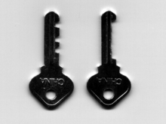
Skeleton keys
All warded locks have the problem that they can be defeated by a skeleton key, a key stripped down to only the part needed to turn the mechanism
In popular culture, the term skeleton key is often misused to mean old style keys for warded locks in general

Slide 17
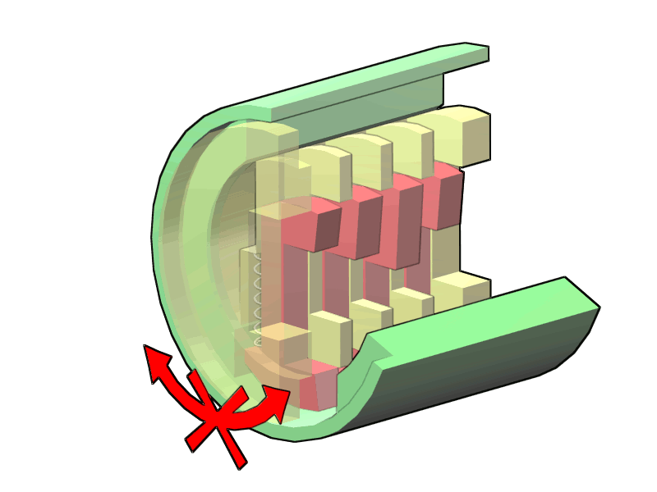
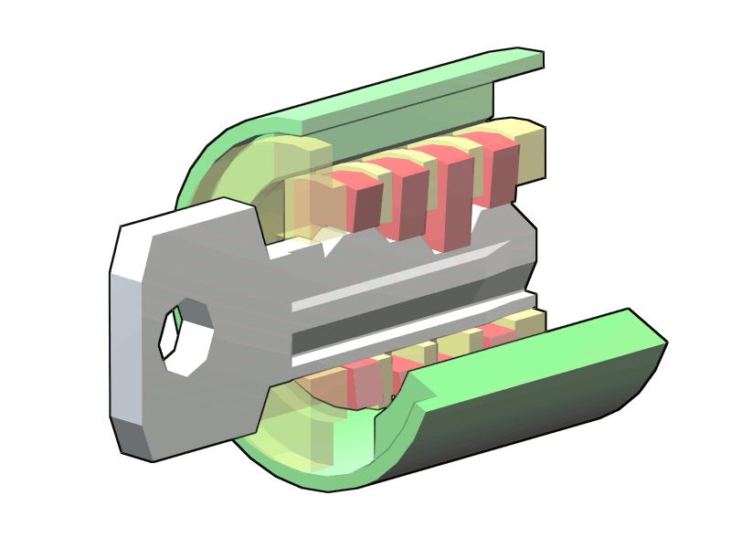
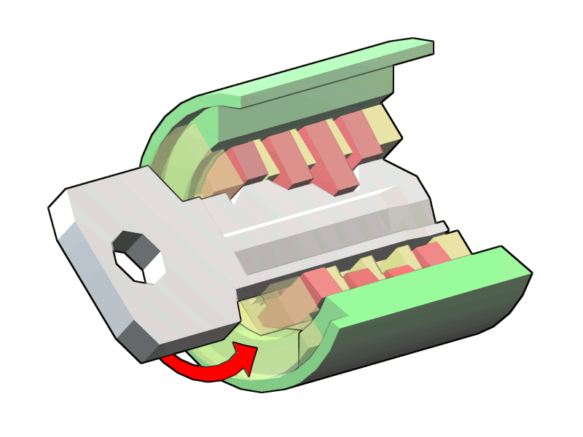
Wafer tumbler locks
Wafer tumbler locks have better security than warded locks
A series of wafers blocks the rotation of a plug
When a key pushes each wafer up to an appropriate height, the plug is free to turn
They are picked in the same way as a pin tumbler lock, but they are easier because you can't push them up too far and you can generally pick each wafer in sequence

Slide 18
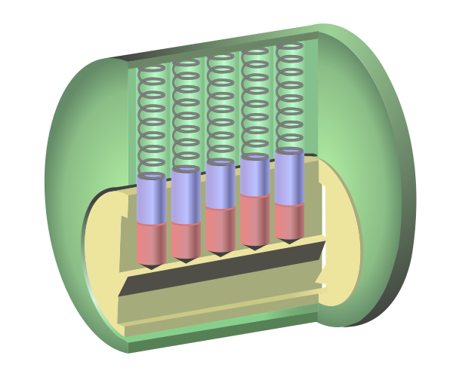
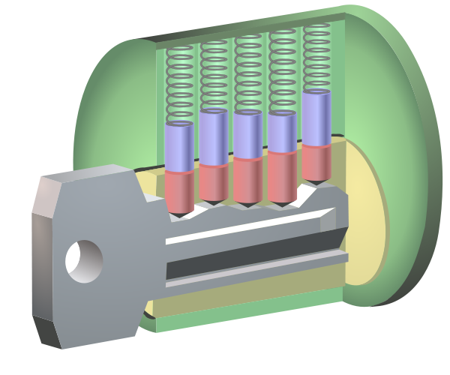
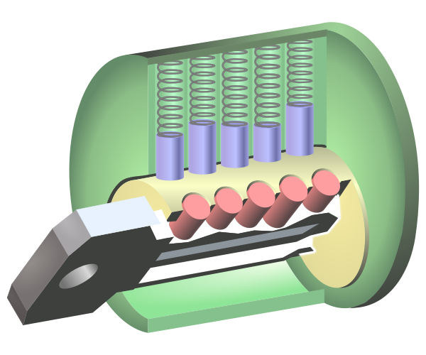
Pin tumbler locks
Most house locks, office locks, and many car locks are pin tumbler locks
Pin tumbler locks are similar to wafer tumbler locks
A series of two part pins blocks the rotation of the plug
A key that pushes all the pins up to their shear lines will allow the plug to turn
Pins that are too high or too low will block the plug
Pin tumbler locks can offer relatively high security at a reasonable cost

Slide 19
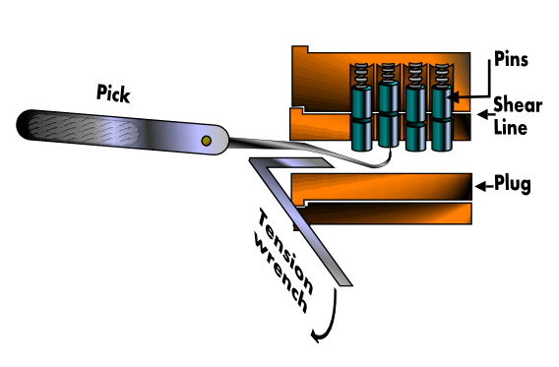
Picking locks
Picking a pin tumbler (or wafer tumbler) lock is done by manipulating each pin (or wafer) into the correct position
It is impossible to machine a lock perfectly, thus, if you try to turn the plug, one pin will be holding more pressure than the others
If you can push that pin up to the shear line, it will snap in place, and another pin will now be holding more pressure
If you can move through all the pins without letting any drop, the plug will turn

Slide 20
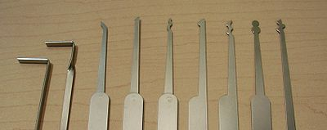
Tools of the trade
You must apply a constant steady turning pressure while picking a lock
This pressure is supplied by a tension wrench
The wrench is usually just an L-shaped piece of spring steel
Picks are also pieces of spring steel with a tip that is good for manipulating pins
Popular picks include hook, ball, half diamond, and other types
A pick set with a tension wrench and broken key extractor can be bought for around $20 on the Internet

Slide 21

Combination locks
Removing combination locks without knowing the combination is called bypassing the lock
Some techniques rely on hearing or feeling clicks made when turning the cams, particularly when pressure is applied to the shank
  Multiple dial combination locks are vulnerable to this attack
All combination locks can be bypassed by brute force (if you have the time)
  Many of the methods rely on the fact that low-security locks are engineered with several digits of play
  This play can be exploited for drastically reduced brute force times (usually still hours)

Slide 22
Ticket Out the Door

Slide 23
Upcoming

Slide 24
Next time…
Protecting programs and data
Intellectual property
Information law
Samuel Costa presents

Slide 25
Reminders
Finish Project 3
  Phase 1 due Friday!
  Files will be posted on Saturday
Read sections 11.1 and 11.2

